Slide 1

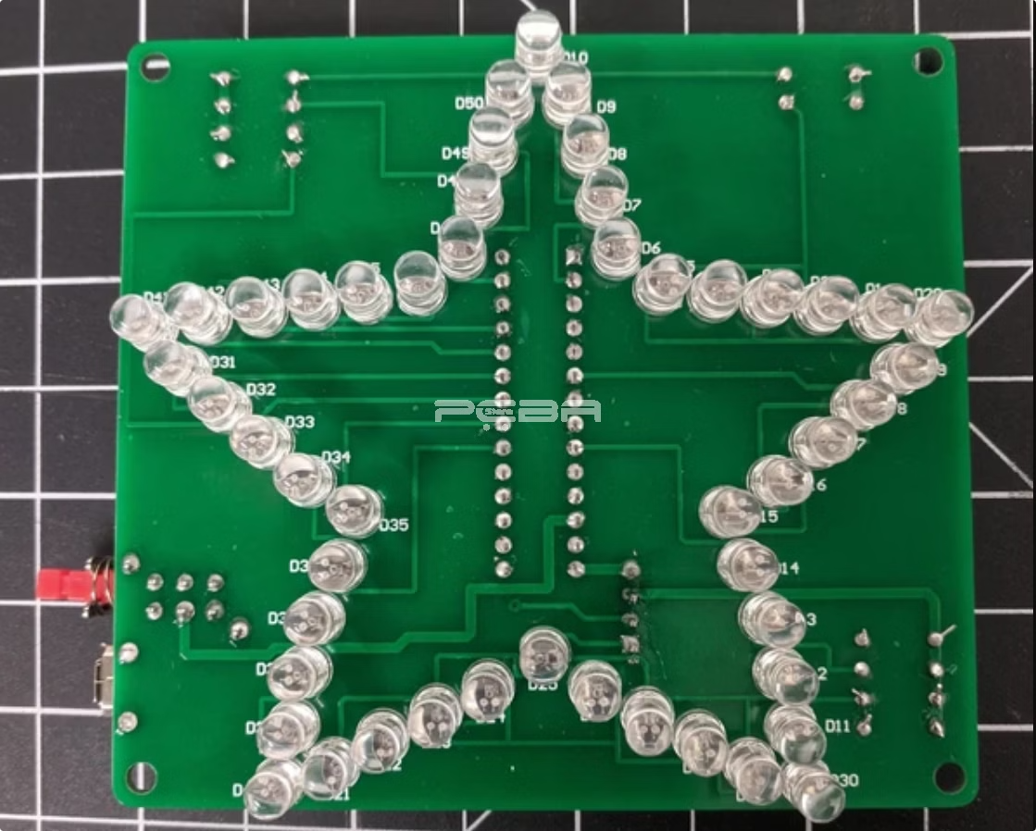

Introduction to LED lights
LED lights are a type of light-emitting diode. They are energy efficient and long lasting, making them a popular choice for lighting.
by Swaraj kumar

Slide 2
Cathode and anode in LED lights
Cathode
Anode
The cathode is the negative terminal of the LED. It is usually marked with a flat side or a shorter lead.
The anode is the positive terminal of the LED. It is usually marked with a rounded side or a longer lead.

Slide 3
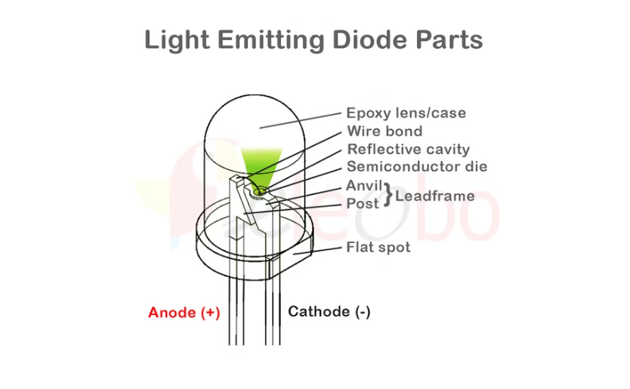
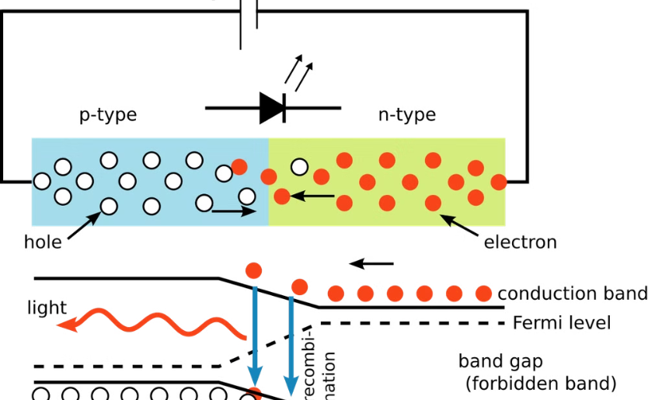
Diagram of LED light structure
Structure
P-N Junction
LED lights consist of a semiconductor material that emits light when electricity flows through it.
The semiconductor material is divided into a p-type and an n-type region, forming a p-n junction.

Slide 4


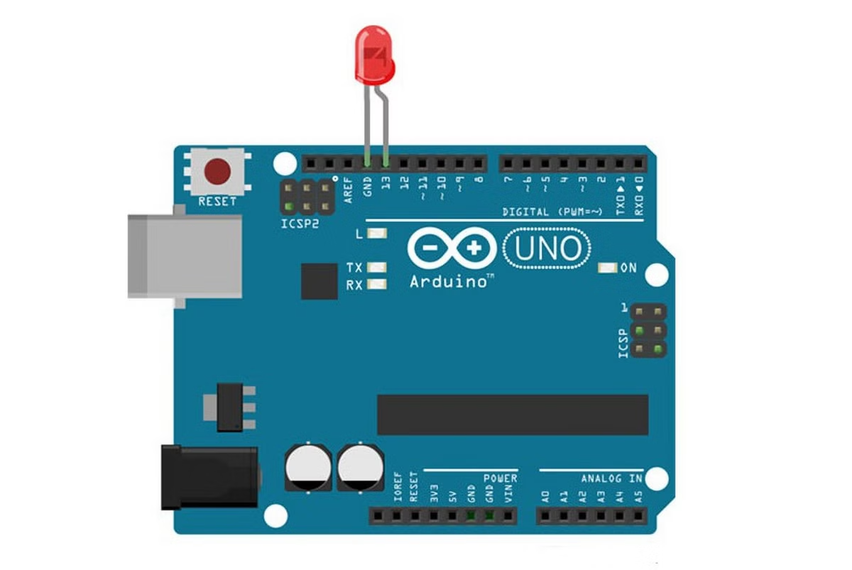


Connecting LED lights to Arduino
Power Supply
Connect the positive leg of the LED to the 5V pin on the Arduino.
Ground
Connect the negative leg of the LED to the GND pin on the Arduino.
Resistor
Connect a resistor (typically 220 ohms) between the positive leg of the LED and the 5V pin. The resistor limits the current flowing through the LED.

Slide 5

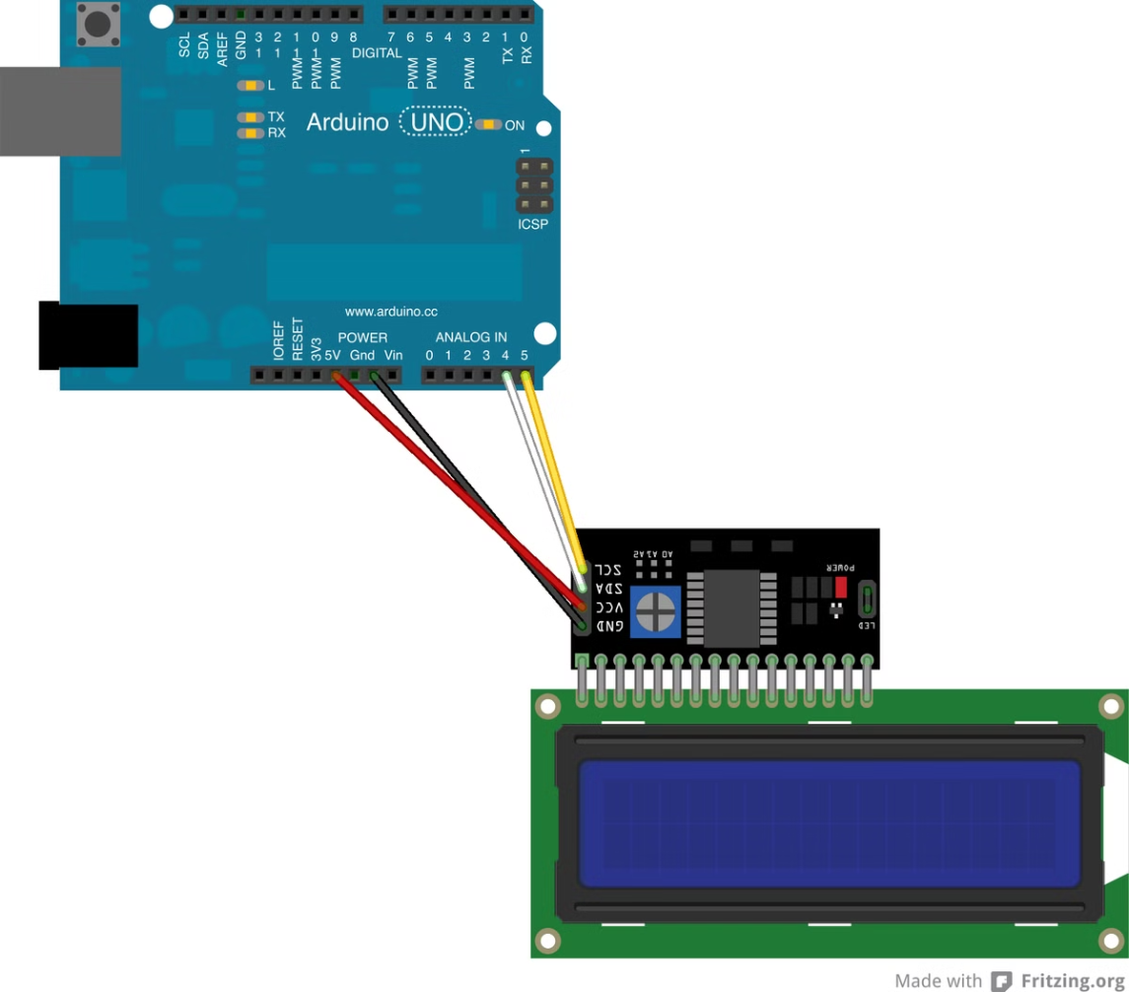
Writing code to control LED lights
Digital Output Pin
Setup Function
Declare an integer variable representing the digital pin to which the LED is connected.
Set the digital output pin as an output in the setup function.
Loop Function
In the loop function, you can write the code to control the LED, such as turning it on or off.

Slide 6

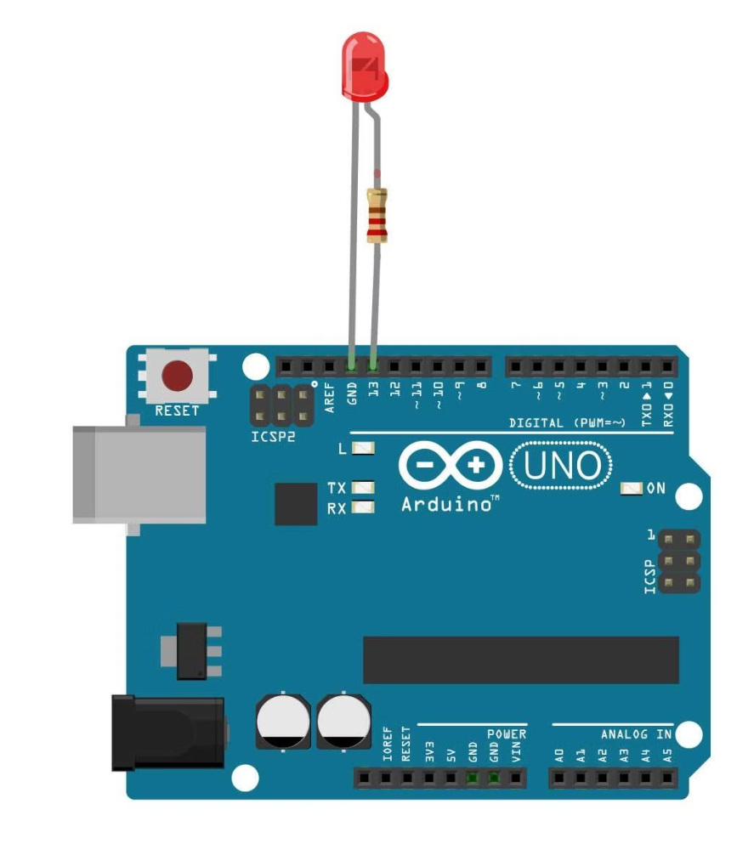
Blinking LED lights with Arduino
1
Set Pin High
2
Delay
Set the digital output pin to HIGH to turn the LED on.
Use the delay() function to pause the program for a specified amount of time.
3
Set Pin Low
4
Repeat
Set the digital output pin to LOW to turn the LED off.
Repeat steps 1-3 to create a blinking effect.

Slide 7

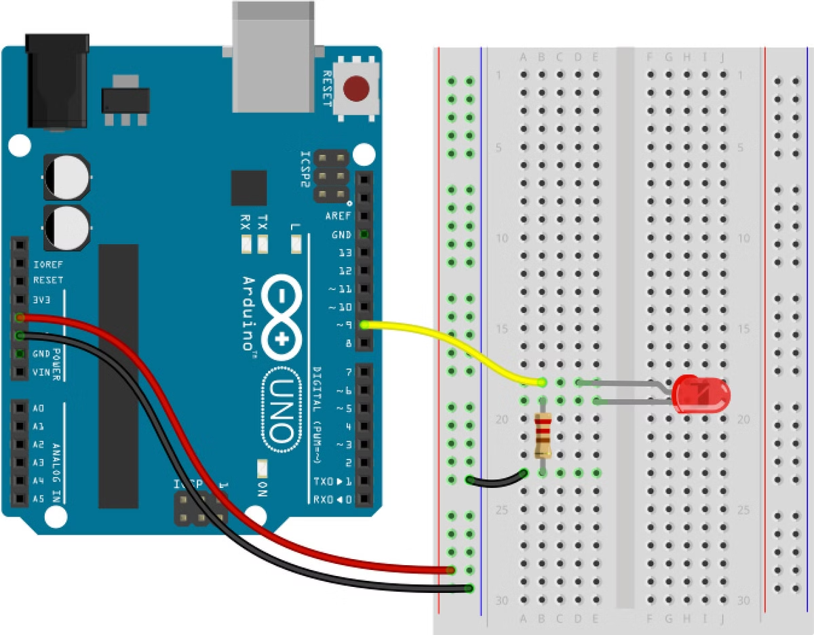
Fading LED lights with Arduino
1
Analog Write
Use the analogWrite() function to control the brightness of the LED by setting a value between 0 and 255.
2
Increase Brightness
Gradually increase the value sent to the analogWrite() function from 0 to 255.
3
Decrease Brightness
Gradually decrease the value sent to the analogWrite() function from 255 to 0.
4
Repeat
Repeat steps 2-3 to create a fading effect.

Slide 8

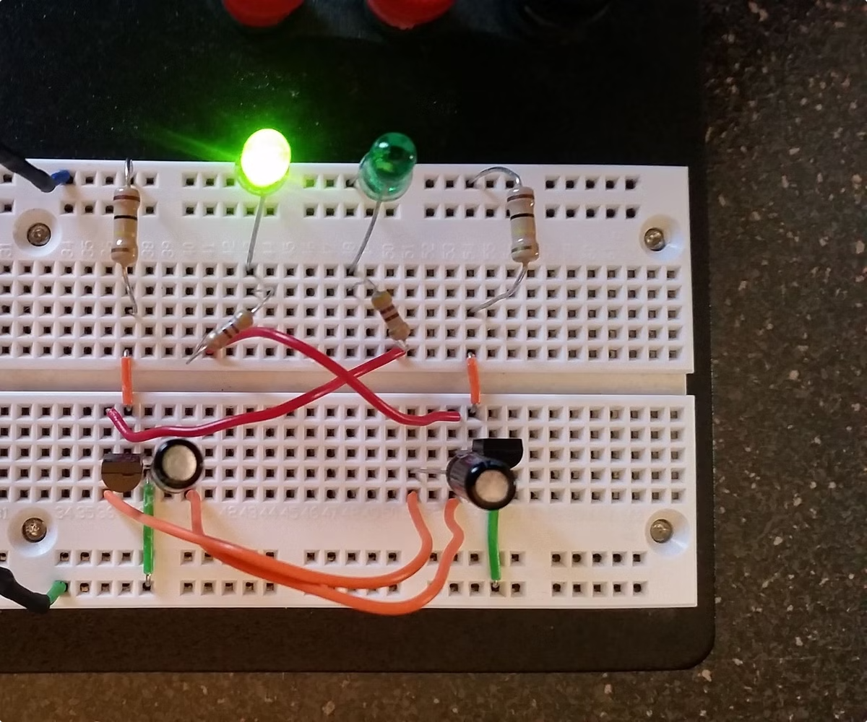
Conclusion and summary
LED lights are versatile and easy to control with Arduino. By understanding the basic concepts of LEDs and Arduino programming, you can create various interesting projects using LED lights.

